Slide 1

Navigating AI Careers & Go-To-Market Strategies
(Ani) Aniriddha Wakchaure
GTM Advisor for Generative AI Startups | UC Davis MSBA Guest Speaker
Education: UC Davis MBA 2023
Electronics Engineer 2006
Notes:
1. Share your weirdest future prediction.
2. What are your target industries or roles?
Activities:
1. Intro 30 sec( Who you are, what you do, like , hate)
2. talk for one min on any topic
3. Convince me of something which everyone thinks is false or weird but you know its true. ( for me its organic)

Slide 2

"You have to dance beautifully in the box that you're comfortable dancing in” -Kobe Bryant
“Courage” means going into the unknown in spite of all the fears. Courage does not mean fearlessness. -Osho (Rajneesh)
"Creativity is intelligence having fun” - Albert Einstein
Notes:
The word courage comes from the Latin word cor which means heart.

Slide 3










Journey
2010
2014
2023
2024
2006
Micron Technology
University of Mumbai - B.E. Electronics
Reka AI - GTM Strategy Leader
Business Partner - Eco Industries
Business Development & Segment Marketing for memory solutions
Flamingo Industries - Founder
Cutting-edge multimodal AI solutions, enerative AI models
Thermal Engineering &
Built warehouse solutions
1
2
3
4
5
6
7
8
9
2008
2012
2021
2024
UC Davis STEM MBA
Key Account Manager managing Apple's ecosystem (AirPods, Watch, AR/VR, Vision Pro, Accessories)
Forbes Marshall - Marketing Engineer
Agasti Energy - Head of Sales
First exposure to B2B marketing and technical sales in industrial automation
Cleantech: biomass briquettes

Slide 4



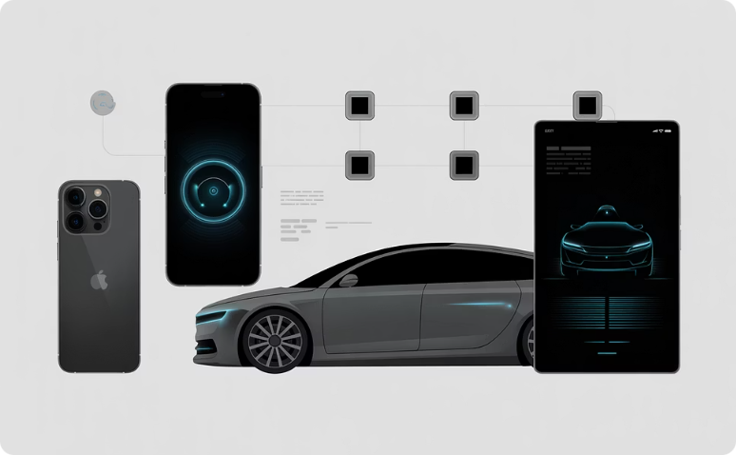
What is AI and How is it Deployed?
Artificial Intelligence means machines that can think and learn like humans
-AI is like having an intern who never sleeps, reads & listens to everything, and gets smarter every day
AI Deployment: Where Does It Run?
Cloud Deployment
On-Premise Deployment
Edge/Device Deployment
Like storing photos on icloudTech:AI runs on powerful remote servers in the cloud, offering flexibility and scalability, accessible from anywhere with internet access
Like keeping photos only on your phone
Tech: AI systems are hosted on a company's own servers, providing maximum security, control, and compliance for sensitive data..
AI that works even without internet Tech: AI operates directly on local devices, cars, or IoT sensors, cameras, and speakers, enabling instant processing and real-time responses without needing to connect to the cloud.

Slide 5






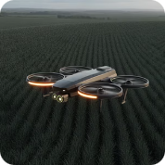



AI Across Industries
Semiconductors & Electronics
Defense & Security
Retail & E-commerce
Manufacturing
Art & Creative
Civil Engineering & Infrastructure
Agriculture
Media & Entertainment
Healthcare
Financial Institutions

Slide 6


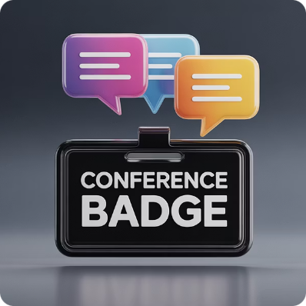


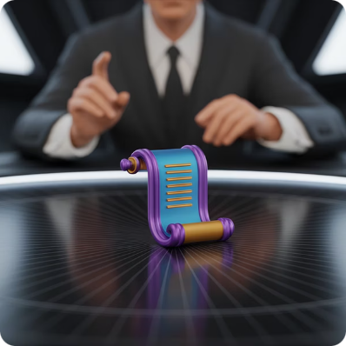


Go-To-Market (GTM)
Go-To-Market strategy is how you take a product, service, or idea to the customer
LinkedIn
Referrals - The Golden Ticket
Events & Conferences
Email Outreach
Alumni Networks
Professors & Academic Advisors
Coffee Chats & Informational Interviews
Company Career Pages

Slide 7
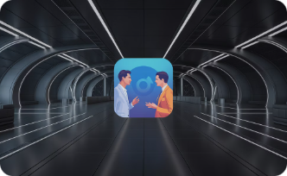




What could we do?
SECRET WEAPON: Mindfullness
Starting Conversations
Being Yourself (Authenticity)
Active Listening (Not Just Waiting to Talk)
Adaptability
Notes:
Try to do stuff with cadence. Or regularity.
Enjoy what you do.
Thing I learnt very late is to love myself. Really.

Slide 8

Let's Stay Connected
(Ani) Aniriddha Wakchaure
Phone: +1 (415) 605-9725
Email: aniriddha.wakchaure@gmail.com
Work Email: ani@ainlabs.tech
LinkedIn: linkedin.com/in/aniriddha
Location: San Francisco, CA
Whether you're exploring AI careers, building a startup, or need GTM advice; I'm here to help. Don't hesitate to reach out. The best opportunities often start with a simple conversation.

Slide 9




Alternate Discussions for Future talks
The Infrastructure: GPUs
Vision agents
The Models: GPT Evolution
Voice agents

